Slide 1
Semiconductor Diode Applications

Slide 2
Semiconductor Diode Applications
One fundamental application of diode is as a rectifier (converts AC waves in to DC).
To create diode logic gates (such as AND or OR gates).
As a clipper that limits or clipped off the voltage beyond the preset value without changing the remaining part of the input waveform.
As a clamper that shifts or alters either positive or negative peak of input signal to desired level.

Slide 3
How to solve diode circuits
There are different diode circuits such as:
Series diode circuits
Parallel diode circuits
Series-parallel diode circuits
Rectifier circuits
Clipper and clamper circuits
Etc.
Circuit analyzing techniques:
Exponential model (Load-line analysis)
Ideal equivalent circuit (1st approximation)
Simplified equivalent circuit (2nd approximation)

Slide 4
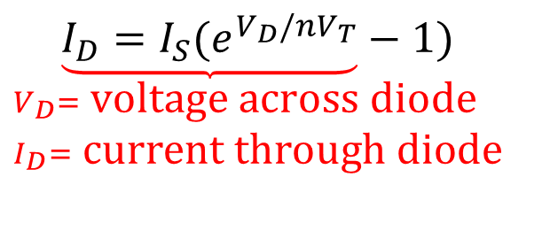
Exponential diode model
Exponential diode model
most accurate, the result found by this model is almost similar to that obtained by Shockley's equation.
most difficult to employ in circuit analysis
due to nonlinear nature
$$\underset{\begin{aligned}&V_{D}= \text{voltage} \text{across} \text{diode} \\ &I_{D}= \text{current} \text{through} \text{diode}\end{aligned}}{\underbrace{I_{D}=I_{S}{(e}^{V_{D}/nV_{T}}}−1)}$$
We use load line (graphical method) to solve exponential model.

Slide 5
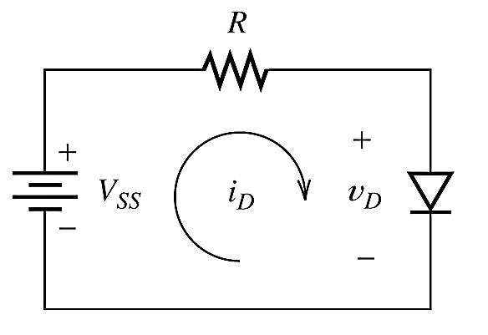
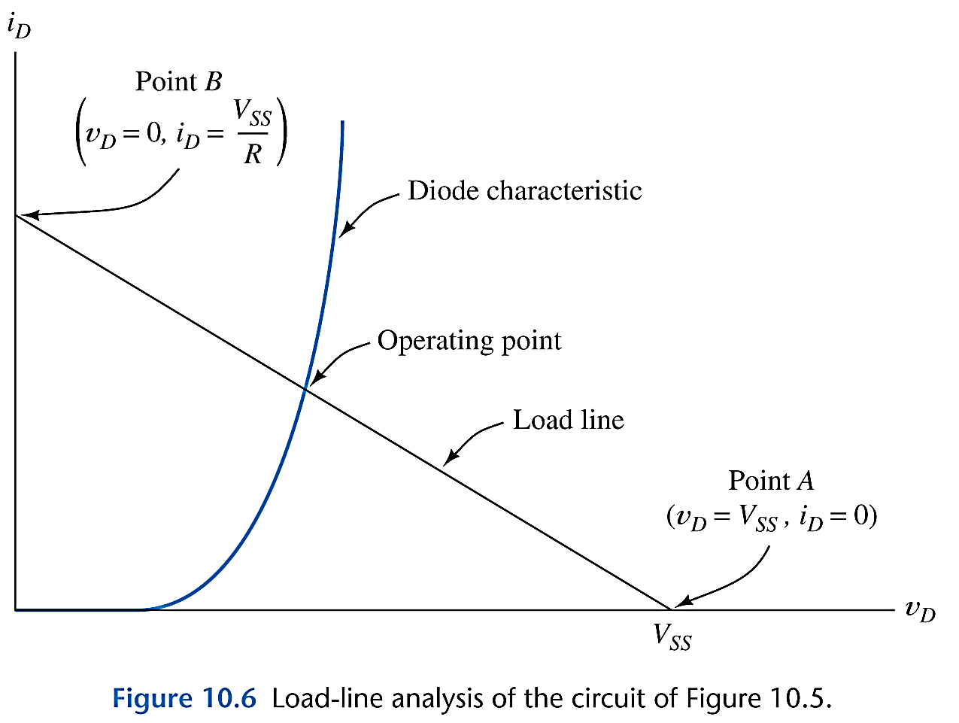
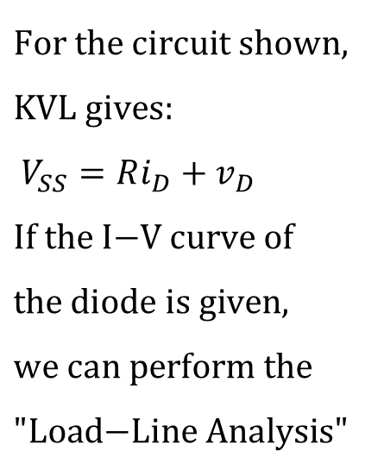
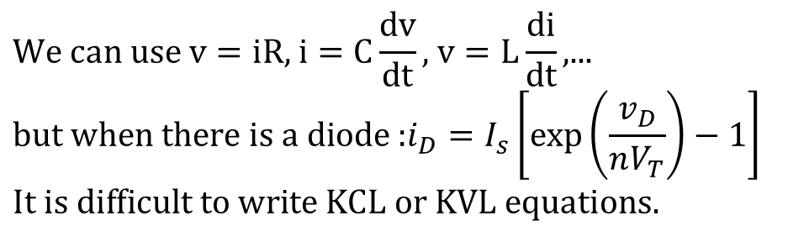
Load-Line Analysis of Diode Circuits
$$\text{We} \text{can} \text{use} \text{v}=\text{iR}\text{, }\text{i}=C\frac{\text{dv}}{\text{dt}}\text{, }\text{v}=L\frac{\text{di}}{\text{dt}}\text{,...} \\ \text{but} \text{when} \text{there} \text{is} \text{a} \text{diode}\text{ :}i_{D}=I_{s}\left[\exp\left(\frac{v_{D}}{nV_{T}}\right)−1\right] \\ \text{It} \text{is} \text{difficult} \text{to} \text{write} \text{KCL} \text{or} \text{KVL} \text{equations}\text{.}$$
$$\text{For} \text{the} \text{circuit} \text{shown}\text{, } \\ \text{KVL} \text{gives}\text{:} \\ V_{SS}=Ri_{D}+v_{D} \\ \text{If} \text{the} \text{I}\text{−}\text{V} \text{curve} \text{of} \\ \text{the} \text{diode} \text{is} \text{given}\text{,} \\ \text{we} \text{can} \text{perform} \text{the} \\ \text{"}\text{Load}\text{−}\text{Line} \text{Analysis}\text{"}$$
Q-point
I_{DQ}
V_{DQ}
The Q-point, which identifies I_{D} and V_{D} for a particular diode in a given circuit.

Slide 6
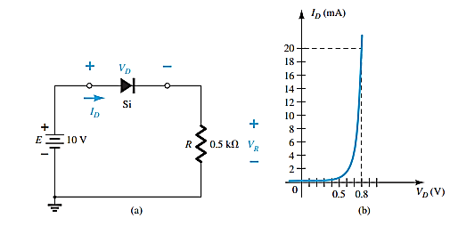
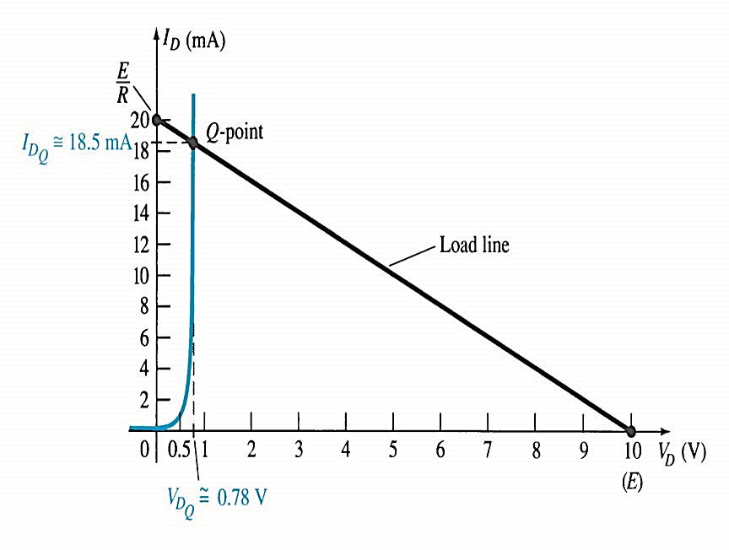
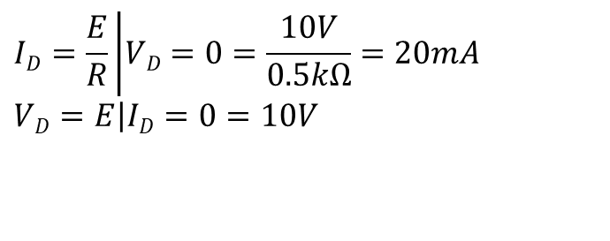
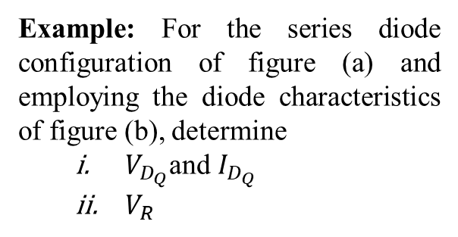
Load-Line Analysis of Diode Circuits
Example: For the series diode configuration of figure (a) and employing the diode characteristics of figure (b), determine
$V_{D_{Q}}$and $I_{D_{Q}}$
$V_{R}$
Solution:
$$ID=\frac{E}{R}\left|VD=0=\frac{10V}{0.5kΩ}\right.=20mA \\ VD=E\left|ID=0\right.=10V$$
From the result, plot the straight line across I_{D} and V_{D}.
The resulting load line appears in the right figure. The Q points occurred at
V_{DQ} ≅ 0.78 V I_{DQ} ≅ 18.5mA
V_{R}=I_{R}R=I_{DQ}R=(18.5 mA)(0.5kΩ) =9.25 V

Slide 7
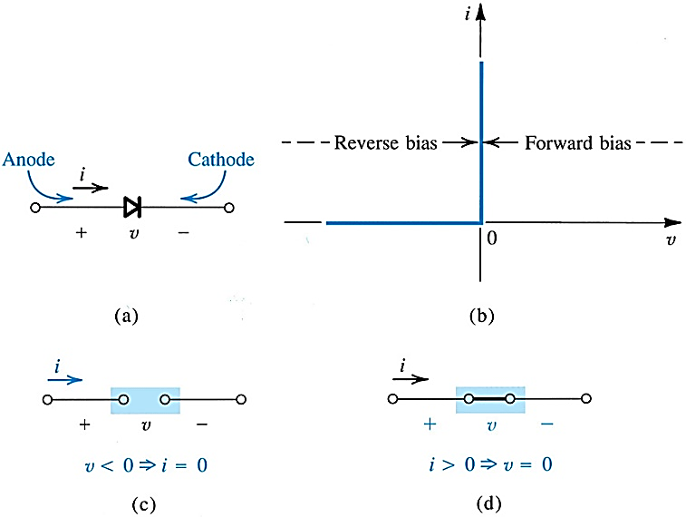
Ideal Equivalent Circuit
The diode is on state if;
The current established by the applied sources is such that its direction matches that of the arrow in the diode symbol.

Slide 8
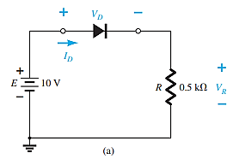
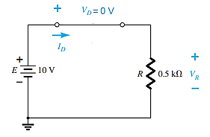
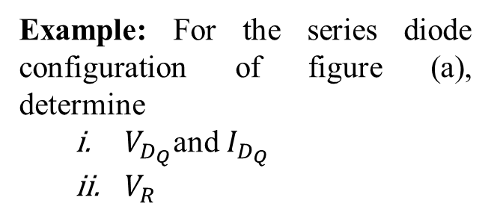
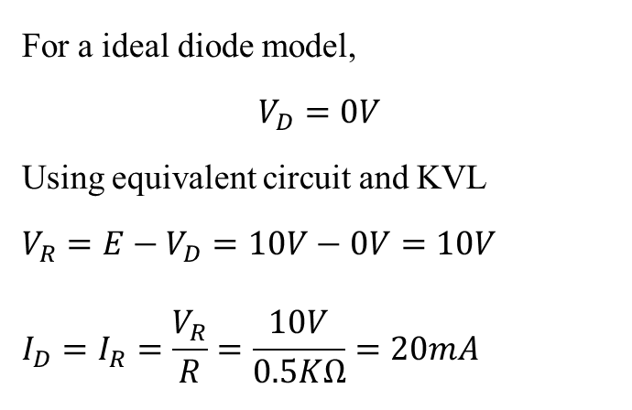
Ideal Equivalent Circuit
Example: For the series diode configuration of figure (a), determine
$V_{D_{Q}}$and $I_{D_{Q}}$
$V_{R}$
Solution:
For a ideal diode model,
$$V_{D}=0V$$
Using equivalent circuit and KVL
$$V_{R}=E−V_{D}=10V−0V=10V \\ I_{D}=I_{R}=\frac{V_{R}}{R}=\frac{10V}{0.5KΩ}=20mA$$
I_{R}
Forward bias

Slide 9
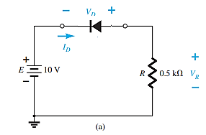
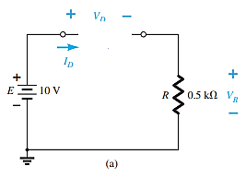
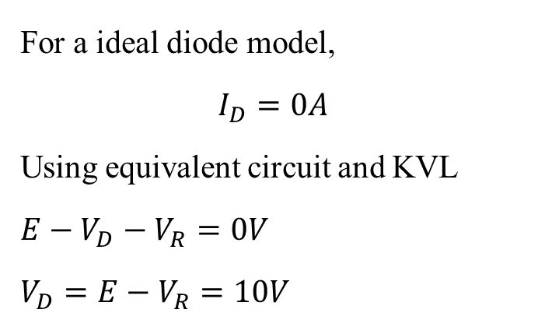
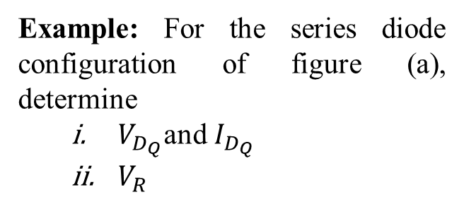
Ideal Equivalent Circuit
Example: For the series diode configuration of figure (a), determine
$V_{D_{Q}}$and $I_{D_{Q}}$
$V_{R}$
Solution:
I_{R}
For a ideal diode model,
$$I_{D}=0A$$
Using equivalent circuit and KVL
$$E−V_{D}−V_{R}=0V$$
$$V_{D}=E−V_{R}=10V$$
= 0 A
Reversed bias

Slide 10
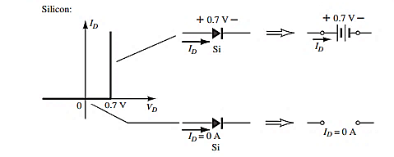
Simplified Equivalent Circuit
The diode is on state if;
The current established by the applied sources is such that its direction matches that of the arrow in the diode symbol.
V_{D} ≥ 0.7 V for silicon, V_{D} ≥ 0.3 V for germanium, and V_{D} ≥ 1.2 V for gallium arsenide.

Slide 11
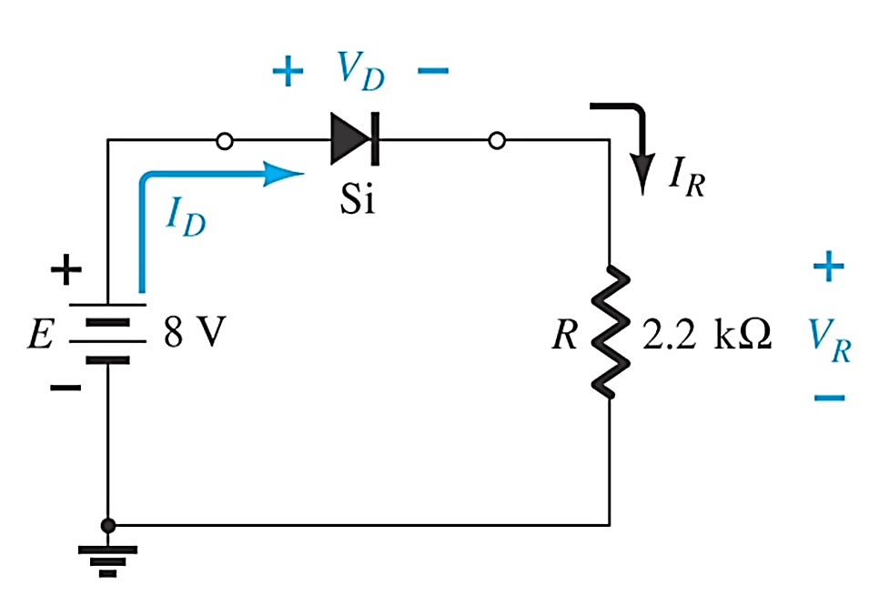
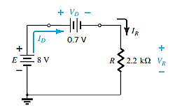
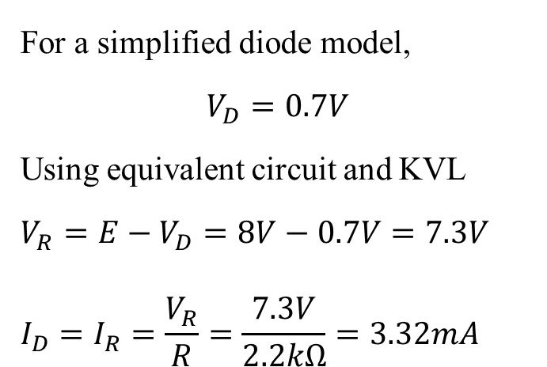
Series Diode Configuration
Example: For the series diode configuration of the following figure, determine V_{D}, V_{R} and I_{D} for forward biasing
Solution:
For a simplified diode model,
$$V_{D}=0.7V$$
Using equivalent circuit and KVL
$$V_{R}=E−V_{D}=8V−0.7V=7.3V \\ I_{D}=I_{R}=\frac{V_{R}}{R}=\frac{7.3V}{2.2kΩ}=3.32mA$$

Slide 12
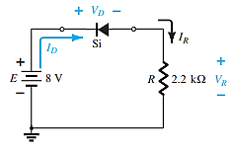
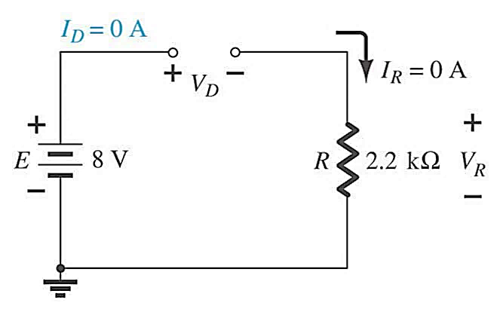
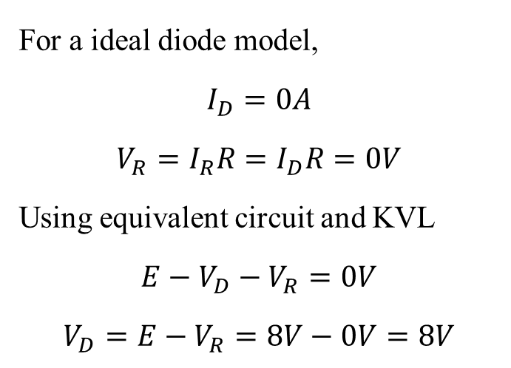
Series Diode Configuration
Example: Repeat previous example with the diode reverse. Thus the equivalent circuit is
Solution:
For a ideal diode model,
$$I_{D}=0A$$
$$V_{R}=I_{R}R=I_{D}R=0V$$
Using equivalent circuit and KVL
$$E−V_{D}−V_{R}=0V$$
$$V_{D}=E−V_{R}=8V−0V=8V$$

Slide 13
When to use these models?
exponential model
low voltages
less complex circuits
emphasis on accuracy over practicality
ideal diode model
high voltages >> 0.7V
very complex circuits
cases where a difference in voltage by 0.7V is negligible
Simplified model:
medium voltages = 0.7V
more complex circuits
emphasis on practicality over accuracy

Slide 14
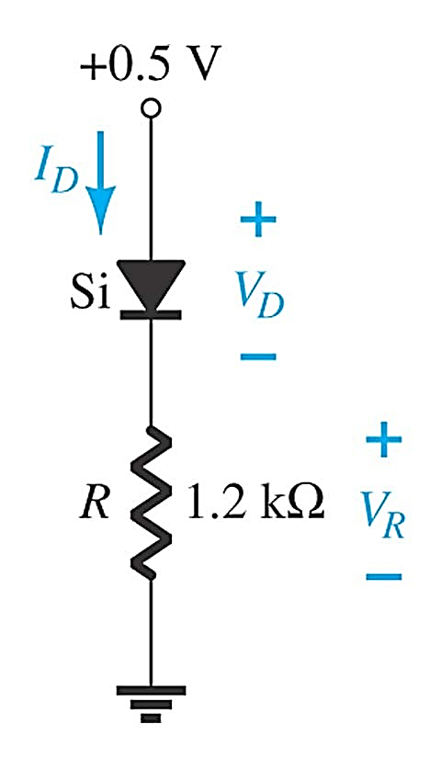
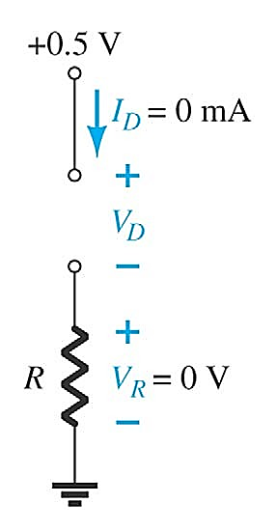
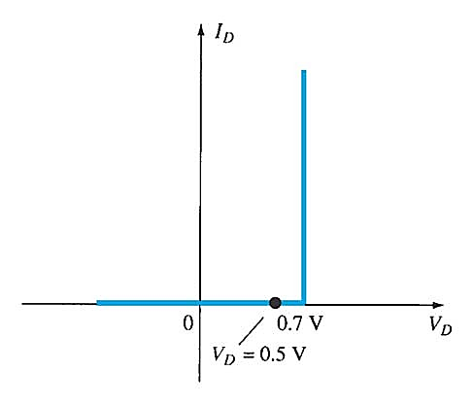
Series Diode Configuration
If the diode is biased with the voltage source less than V_{D}, the diode also acting like open circuit
Diode Circuit
Diode Characteristic
With biasing less than 0.7V
Equivalent cct

Slide 15
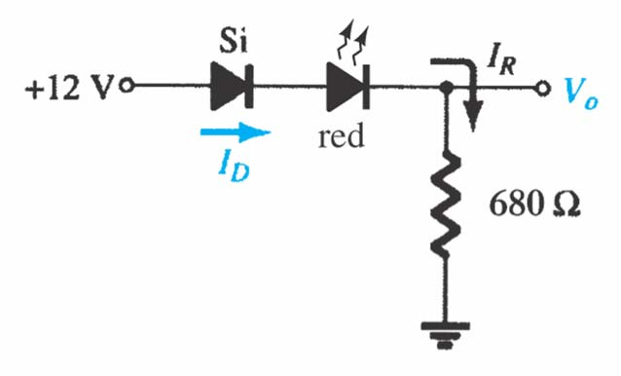
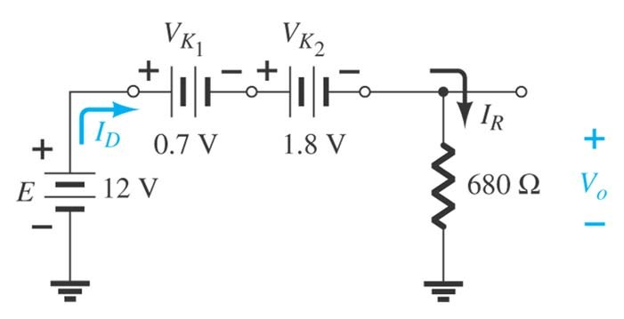

Series Diode Configuration
Example: Determine V_{o} and I_{D} for the series circuit below
Using equivalent circuit and KVL
V_{o} = E − V_{K1} − V_{K 2} = 12V − 0.7V − 1.8V = 9.5V
$$I_{D}=I_{R}=\frac{V_{R}}{R}=\frac{9.5V}{0.68kΩ}=13.97mA$$

Slide 16

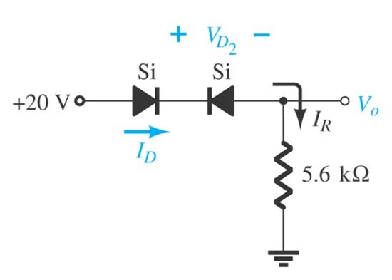
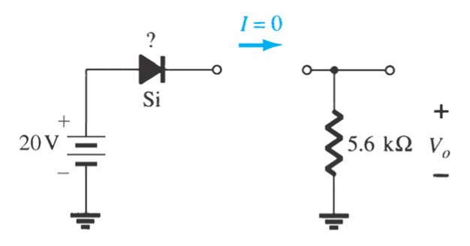
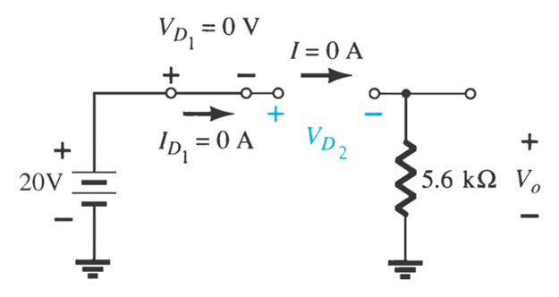

Series Diode Configuration
Example: Determine I_{D} , V_{D2} and V_{o} for the circuit below
Since, open circuit,
$$I_{D}=0A$$
$$V_{D_{1}}=0V$$
$$V_{0}=I_{R}R=I_{D}R=0×R=0V$$
And using KVL, we have
$V_{D_{2}}=E−$ $V_{D_{1}}$- $V_{0}$=20V-0V-0V=20V

Slide 17
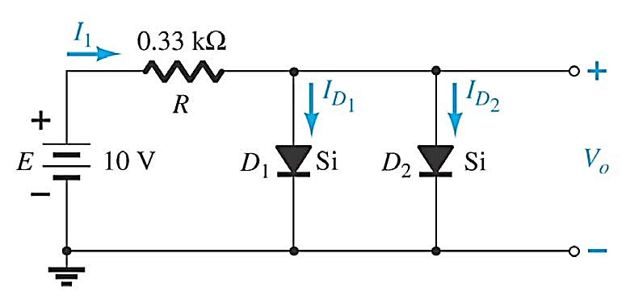
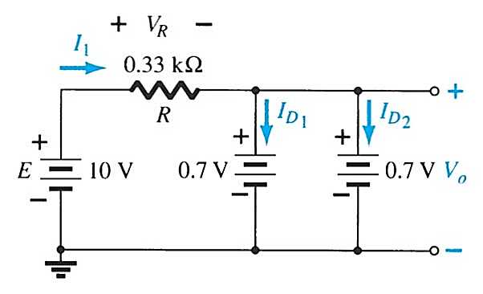
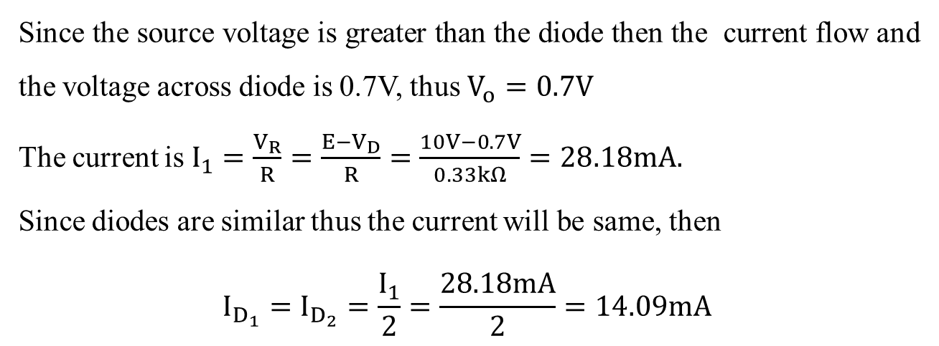
Parallel Diode Configuration
Example: Determine V_{o}, I₁, I_{D1} and I_{D2} for the parallel diode below
Since the source voltage is greater than the diode then the current flow and the voltage across diode is 0.7V, thus $V_{o}=0.7V$
The current is $I_{1}=\frac{V_{R}}{R}=\frac{E−V_{D}}{R}=\frac{10V−0.7V}{0.33kΩ}=28.18mA.$
Since diodes are similar thus the current will be same, then
$$I_{D_{1}}=I_{D_{2}}=\frac{I_{1}}{2}=\frac{28.18mA}{2}=14.09mA$$

Slide 18
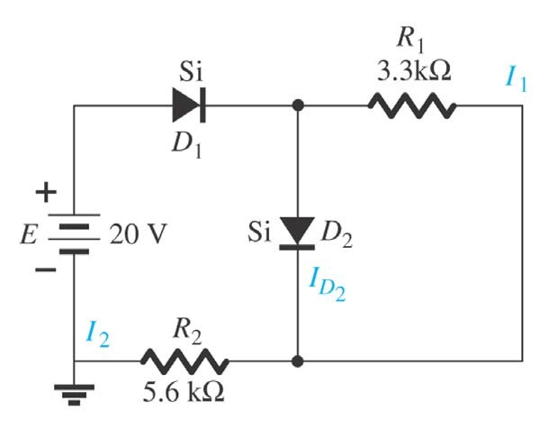
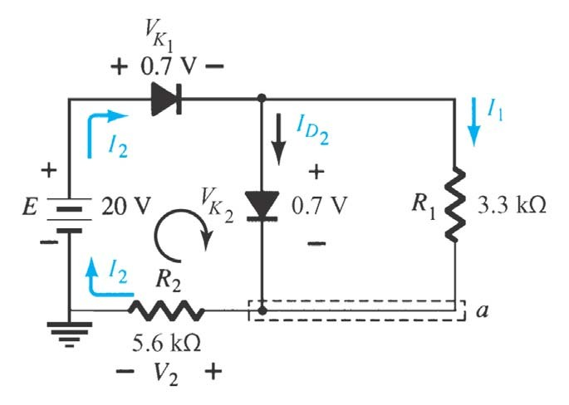
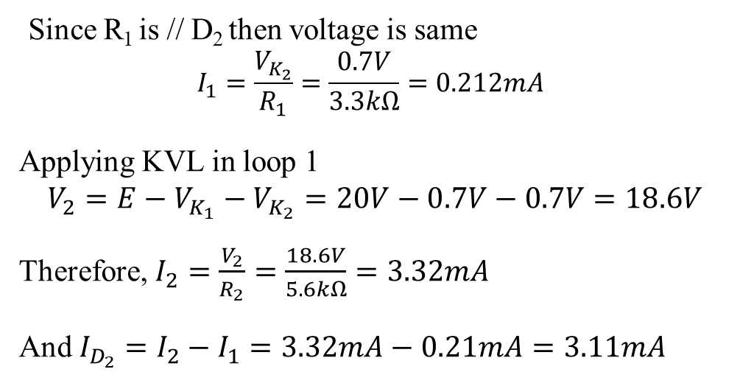
Series-Parallel Diode Configuration
Example: Determine the currents I₁, I₂ and I_{D} for the network below
Since R₁ is // D₂ then voltage is same
$$I_{1}=\frac{V_{K_{2}}}{R_{1}}=\frac{0.7V}{3.3kΩ}=0.212mA$$
Applying KVL in loop 1
$$V_{2}=E−V_{K_{1}}−V_{K_{2}}=20V−0.7V−0.7V=18.6V$$
Therefore, $I_{2}=\frac{V_{2}}{R_{2}}=\frac{18.6V}{5.6kΩ}=3.32mA$
And $I_{D_{2}}=I_{2}−I_{1}=3.32mA−0.21mA=3.11mA$

Slide 19
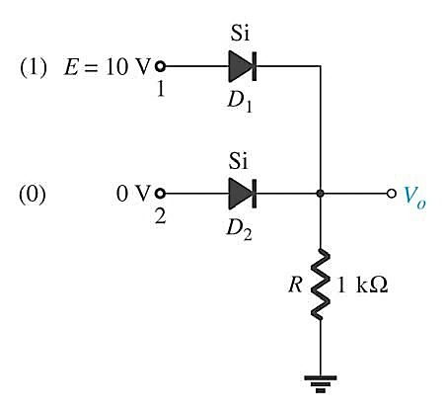
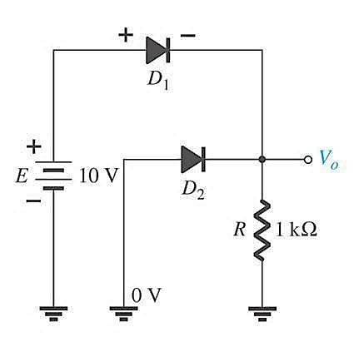
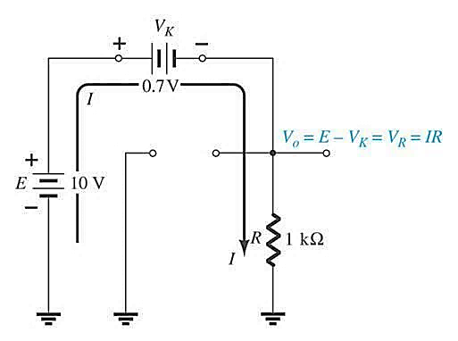

OR GATE
Example: Determine V_{o} and I for network below
I
Solution:
From fig. on the right apply KVL
V_{o} = E − V_{D} = 10V − 0.7V = 9.3V
Input |  | Output, V_{o}
V₁ | V₂
10V | 0 | 9.3V
0 | 10V | 9.3V
10V | 10V | 9.3V
0V | 0V | 0V
and
$$I=\frac{E−V_{D1}}{R}=\frac{10V−0.7V}{1KΩ}=9.3mA$$
Truth table of OR gate

Slide 20
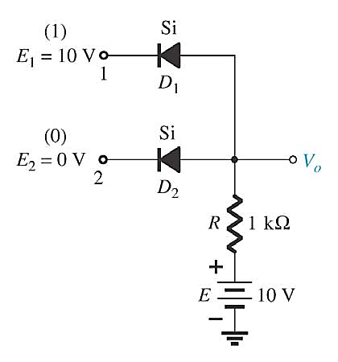
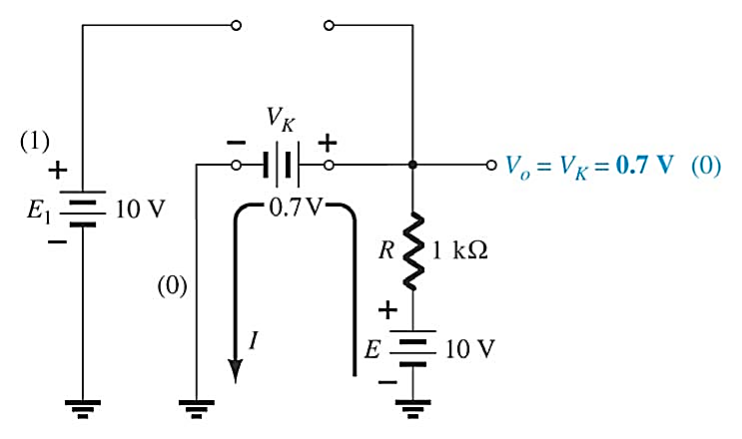
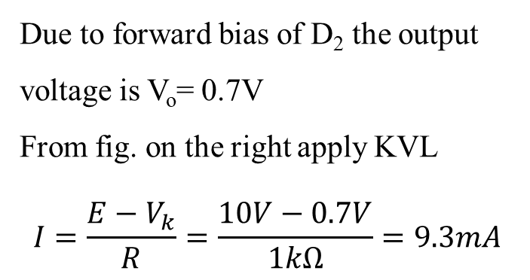
AND GATE
Example: Determine the output level for the positive logic AND gate below
Due to forward bias of D₂ the output voltage is V_{o}= 0.7V
From fig. on the right apply KVL
$$I=\frac{E−V_{k}}{R}=\frac{10V−0.7V}{1kΩ}=9.3mA$$
Input |  | Output, V_{o}
E₁ | E₂
10V | 0 | 0.7V
0 | 10V | 0.7V
10V | 10V | 10V
0V | 0V | 0.7V
Truth table of AND gate

